Slide 1
Theory 1; Principles of Machine Learning
Notes:
## Theory 1: Principles of Machine Learning
**(100 min)**
- **Principles of Machine Learning**
Machine learning involves creating algorithms that enable computers to learn from data and make predictions.
In toxicology, machine learning can be used to predict the toxicity of chemical compounds by analyzing patterns
in biological data. For example, models can be trained to identify potential carcinogens based on historical data.
- **What is AI, and which flavours? History of AI**
AI encompasses various technologies, including machine learning, that simulate human intelligence.
In chemical hazard assessment, AI can automate the analysis of large datasets to identify hazardous chemicals.
The history of AI in this field includes the development of expert systems that assist in regulatory
compliance and risk assessment.
- **Architecture - algorithm? Regression based vs neural network**
Regression models, such as logistic regression, are used to predict binary outcomes like
the presence or absence of a toxic effect. Neural networks, on the other hand, can model complex relationships
in data, such as predicting the interaction effects of multiple chemicals on human health.
- **What is a neural network, building blocks**
Neural networks consist of interconnected neurons that process data in layers. In toxicology, neural
networks can be used to model dose-response relationships, where the input layer represents chemical
concentrations and the output layer predicts biological responses.
- **Embedding; from data to numbers, examples, tensors, vectors**
Embedding techniques convert categorical data, such as chemical names, into numerical vectors that
can be processed by machine learning models. In chemical hazard assessment, embeddings can represent
molecular structures, allowing models to learn from structural similarities between compounds.
- **Features, feature space (materials from AIRA course)**
Features in machine learning are the input variables used to make predictions. In toxicology, features
might include molecular weight, solubility, and other physicochemical properties. The feature space is the
multidimensional space where these features are represented, and effective feature selection is crucial for
accurate predictions.
- **Validation, cross-validation, leave-one-out, metrics of performance**
Validation techniques ensure the reliability of machine learning models. In chemical hazard assessment,
cross-validation can be used to evaluate models that predict the environmental impact of chemicals. Performance
metrics such as sensitivity and specificity are important for assessing model accuracy in identifying hazardous
substances.
- **Which models are used?**
Various models are used in machine learning, including decision trees, which can classify chemicals based
on their hazard potential, and support vector machines, which can separate toxic from non-toxic compounds.
Deep learning models, such as convolutional neural networks, are increasingly used for image-based toxicity
screening.

Slide 2


Principles of Machine Learning
https://ontox-project.eu/
http://tinyurl.com/mltox-lecture
Marc A.T. Teunis, PhD,
Associate professor,
University of Applied Sciences, Utrecht
The Netherlands
PET Course NAMs in Toxicology, 14 December, 2023

Slide 3
Theory 1 – Principles of Machine Learning
What is AI, what types of AI are there?
Architecture - Algorithm Regression based, neural networks
Validation, cross-validation, leave-one-out, metrics of performance
History of AI
Embedding; from data to numbers, tensors, vectors

Slide 4

Managing expectations
“Create an image showing the concept 'manage expectations' in relation to me giving a 1.5 hour lecture on AI in toxicology. It is way not enough time to introduce people to AI, so we are merely scratching the surface. If you want to learn more and want to start using AI in your own work, I highly recommend taking a series of courses.
e.g.:
https://www.coursera.org/specializations/data-science-statistics-machine-learning
DALL-E, December 2023

Slide 5
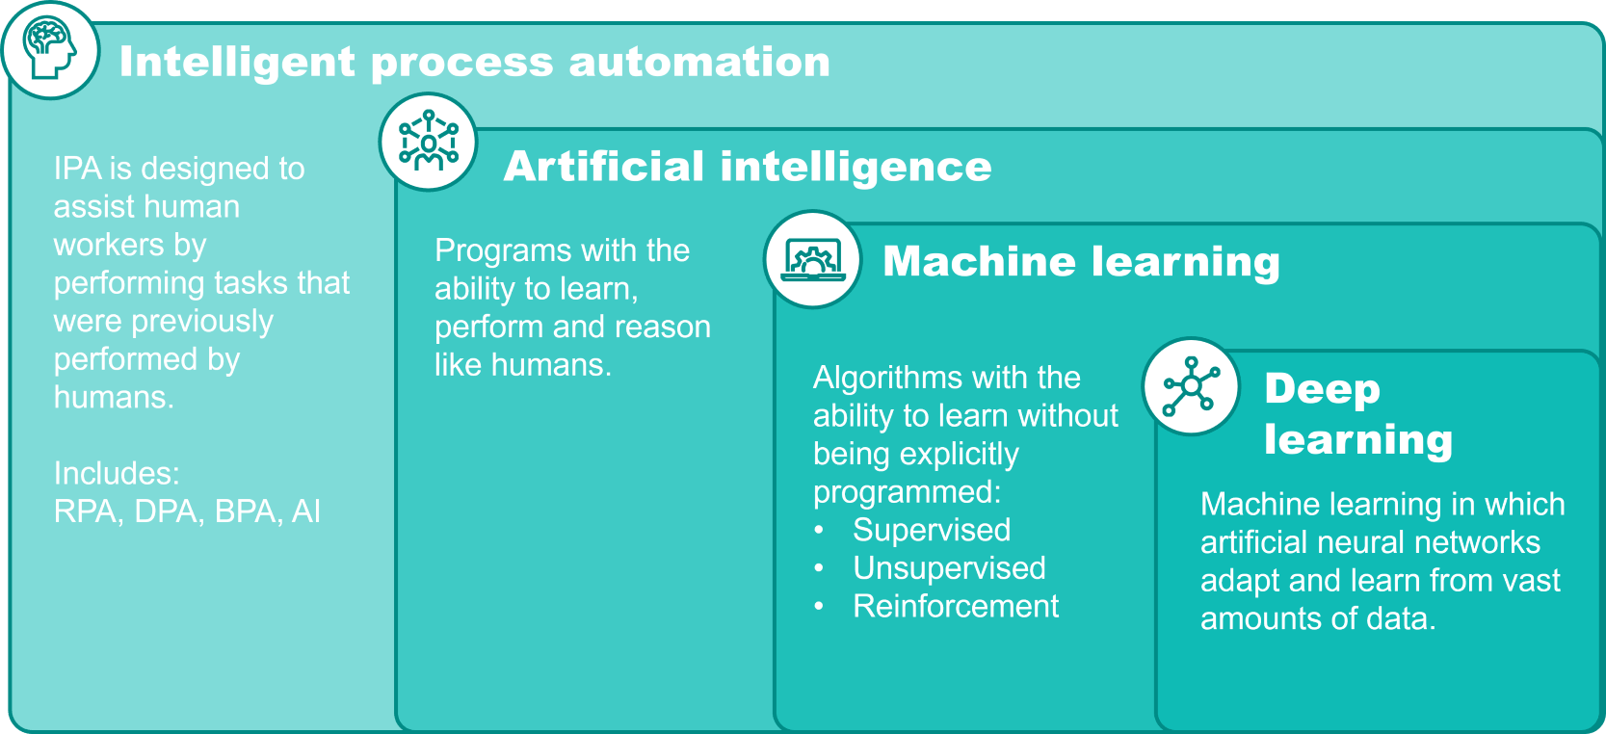
Artificial Intelligence
ToxPilot?
"the theory and development of computer systems able to perform tasks normally requiring human intelligence, such as visual perception, speech recognition, decision-making, translation between languages, and generation of content.
https://www.bakertilly.com/insights/the-ai-technology-landscape-explained

Slide 6
Machine learning
In machine learning, the ‘machine’ is presented with examples relevant to the task and needs to figure out the rules.
Rules
Classical programming for problem solving
Answers
Data
Data
Machine Learning
Rules
Answers
Adapted from Deep Learning with R, Cholet & Allaire, 2019
Notes:
Many of the classical statistical approaches are build according the first box. ML is fundamentally different because there is no direct instruction on how the problem needs to be solved. Only the data and the expected outcome are provided, the algorithm figures out the set of rules to arrive at new answers when new data (not seen before) are presented.

Slide 7
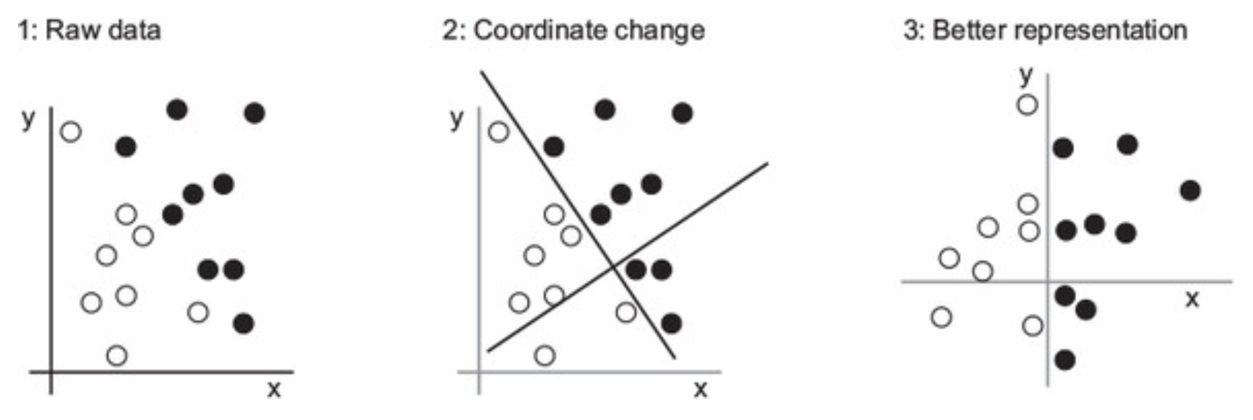
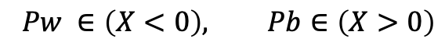
Elementary algorithm
Construct an algorithm that can classify a dot for class ‘white’ or ‘black’
$$Pw ∈\left(X<0\right), Pb∈\left(X>0\right)$$
Example adapted from Deep Learning with R, Cholet & Allaire, 2019
Notes:
All machine-learning algorithms consist of automatically finding such transformations that turn data into more-useful representations for a given task. These operations can be coordinate changes, as you just saw, or linear projections (which may destroy information), translations, nonlinear operations (such as “select all points such that x > 0”), and so on. Machine-learning algorithms aren’t usually creative in finding these transformations; they’re merely searching through a predefined set of operations, called a hypothesis space.
So that’s what machine learning is, technically: searching for useful representations of some input data, within a predefined space of possibilities, using guidance from a feedback signal. This simple idea allows for solving a remarkably broad range of intellectual tasks, from speech recognition to autonomous car driving.
Now that you understand what we mean by learning, let’s take a look at what makes deep learning special.

Slide 8

Steps to build machine learning models (CRISP-DM)
https://en.wikipedia.org/wiki/Cross-industry_standard_process_for_data_mining

Slide 9
Start with Exploratory Data Analysis & use code to do it.
For robustness, traceability and reproducibility:
Applying the 7 principles of Guerilla Analytics is highly desirable.
Principle 1: Space is cheap, confusion is expensive
Principle 2: Prefer simple, visual project structures and conventions
Principle 3: Prefer automation with program code
Principle 4: Maintain a link between data on the file system, data in the analytics environment, and data in work products
Principle 5: Version control changes to data and analytics code
Principle 6: Consolidate team knowledge in version-controlled builds
Principle 7: Prefer analytics code that runs from start to finish
Check data quality, exploratory data analysis
Subset data
Clean data
Feature engineering
Enrich data from external sources
Investigate effects of imputation
Explore patterns with inferential statistics
Prepare data for analysis -> transform data to tensors
EDA = Exploratory Data Analysis, see for tips in R:
https://bookdown.org/rdpeng/exdata/ by Roger Peng
https://guerrilla-analytics.net/the-principles/

Slide 10



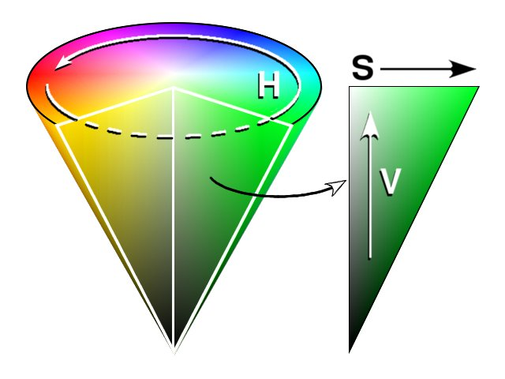
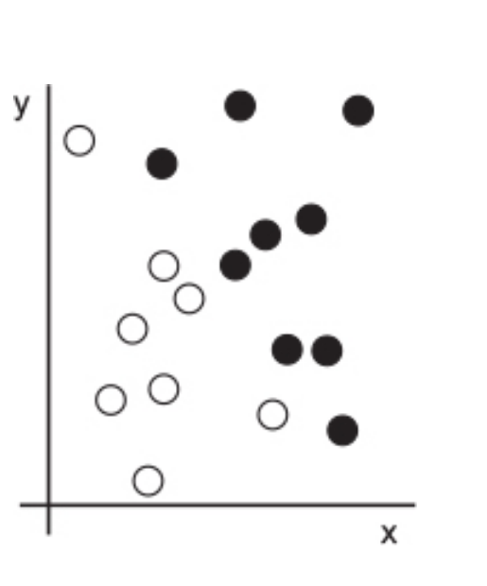
What do we need for machine learning?
Classify pictures that contain much green
Machine learning algorithm
RGB
Optimize the amount of saturation for the input picture
HSV
How is the data represented to answer the output question?
Based on coordinates,
what color is our point?
INPUT DATA
A way to measure whether the algorithm is doing a good job
Example adapted from Deep Learning with R, Cholet & Allaire, 2019

Slide 11
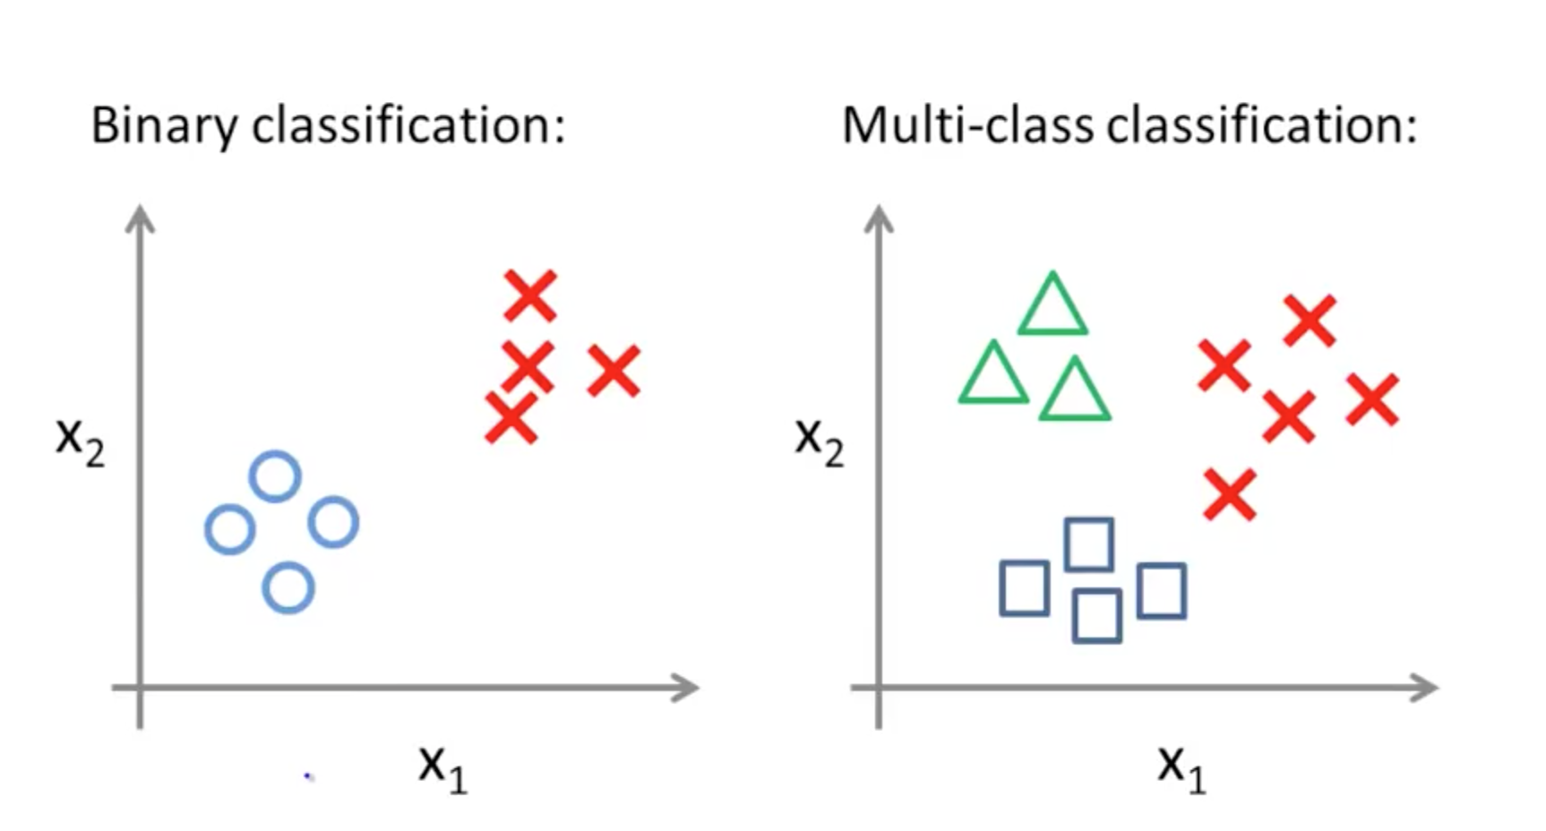
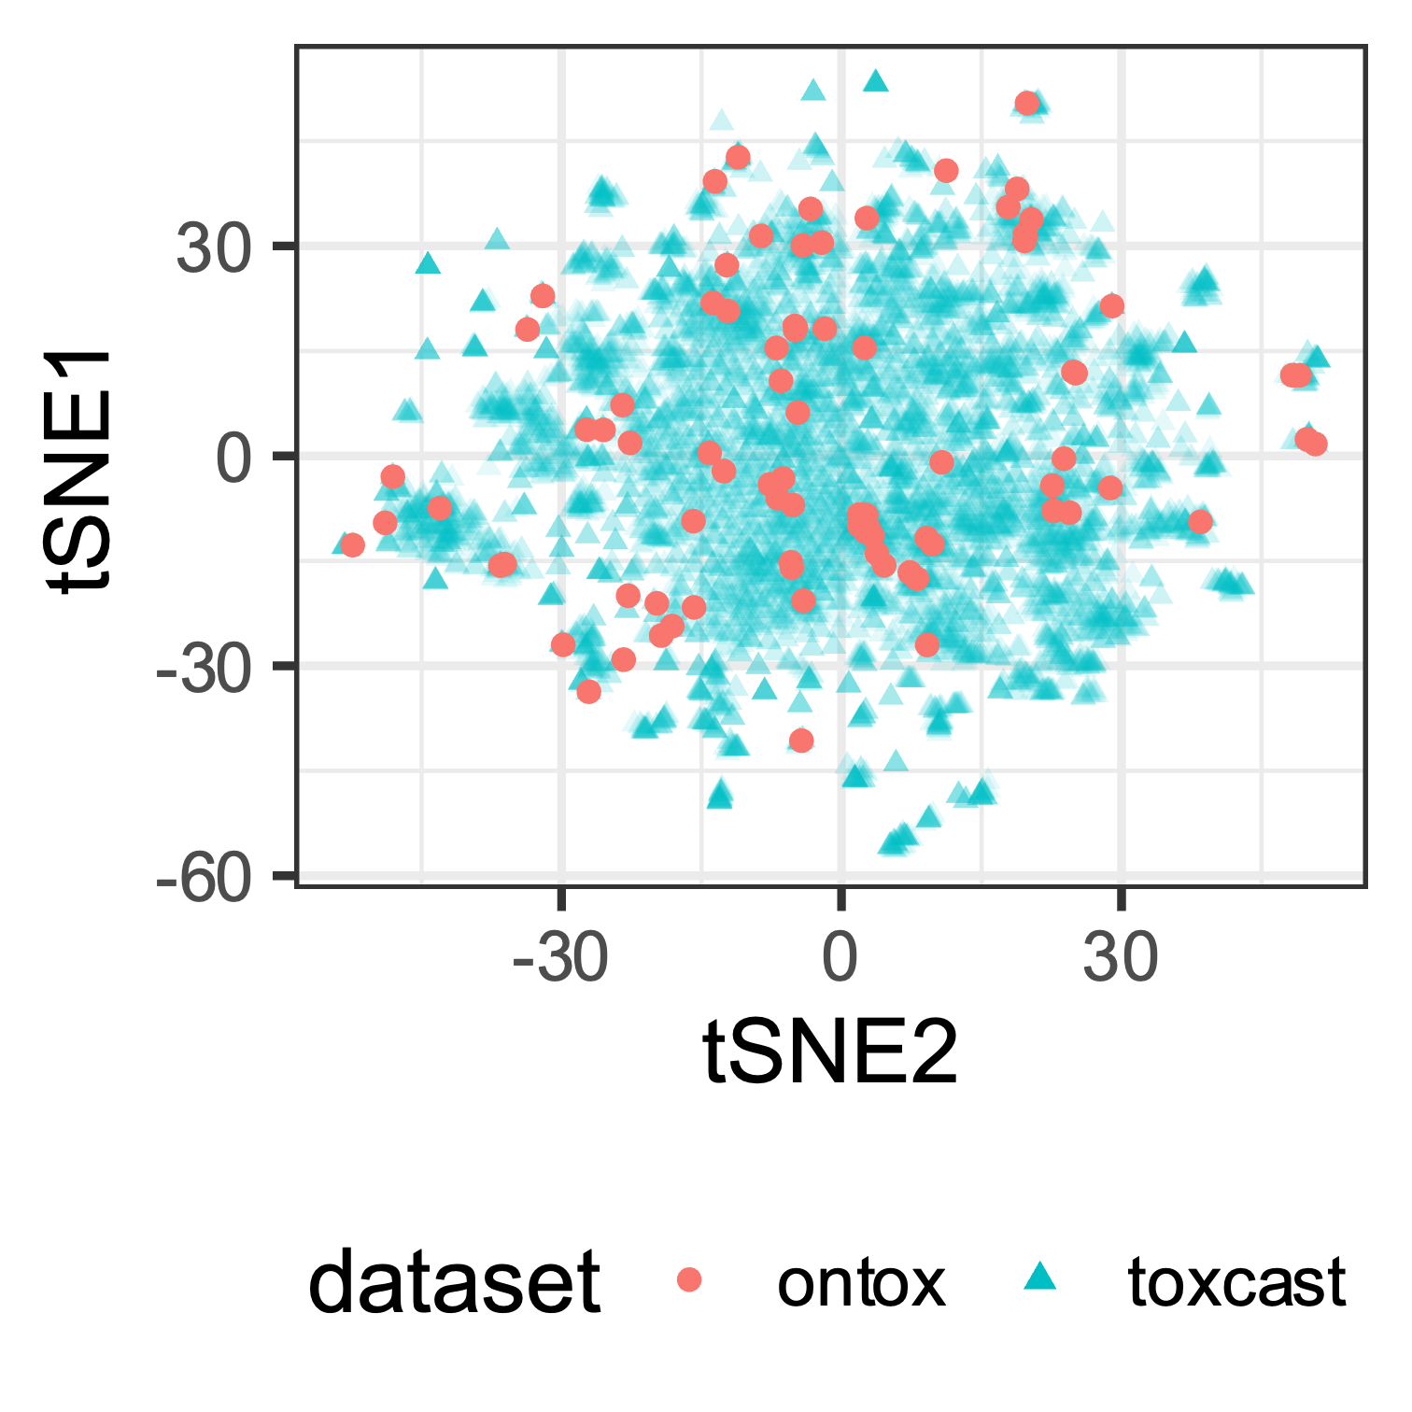
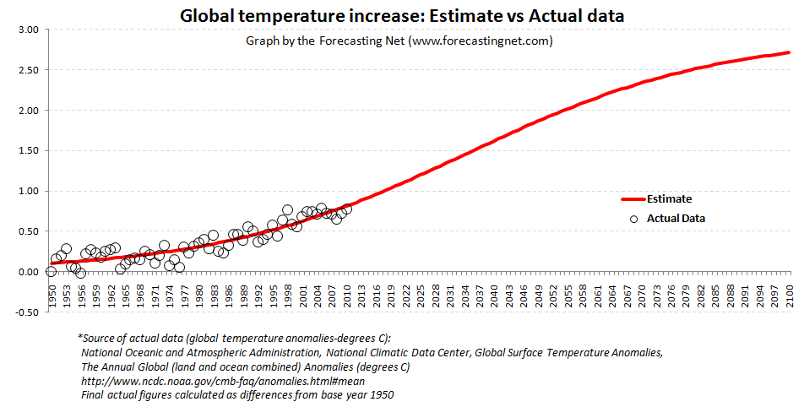
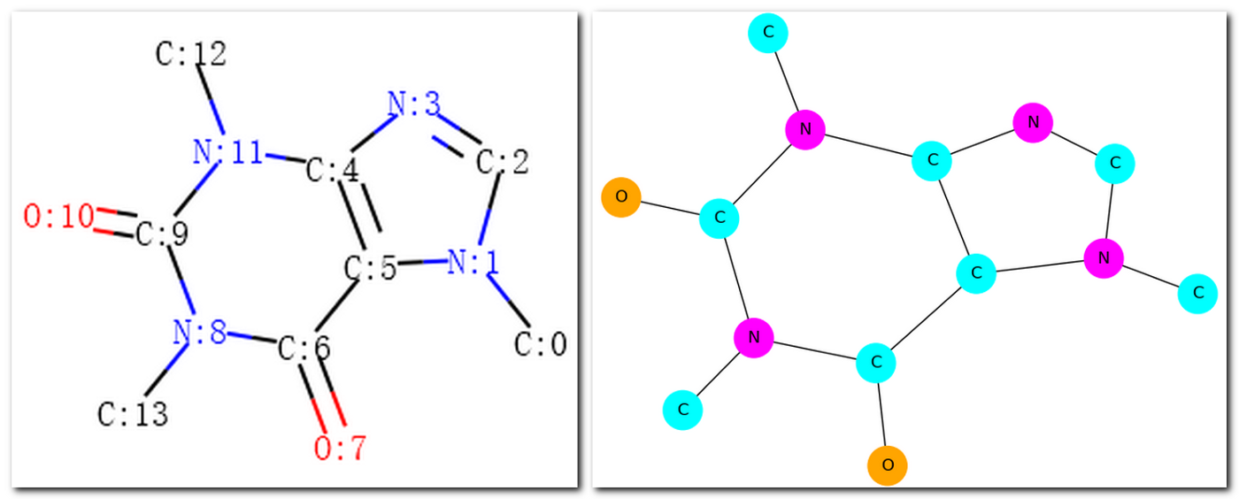
Chosing an ML model -> Articulate the problem
Classification
Needs labelled data
Binary vs Multi-class
ML and DL methods
Clustering
Unlabeled data
ML and DL methods
Rank
List of ranked objects
ML and DL methods
Graph
Fragments and structures
Graph embeddings
DL methods
Regression
Numeric output
ML and DL methods
Time series, forcasting
Notes:
First and foremost, the most important questions to ask are (1) “what are you attempting to solve for?” (2) “What is the desired outcome?”
However, we must continuously remind ourselves that AI cannot be the panacea in itself. It’s a tool, not the entire solution itself. There are several techniques and many different problems to solve with AI.
Think about this analogy that helps to explain the above. If you want to cook a tasty dish you have to know exactly what you are going to cook and all the ingredients that you need.

Slide 12

Types of AI?

Slide 14
What is deep learning?

Slide 15
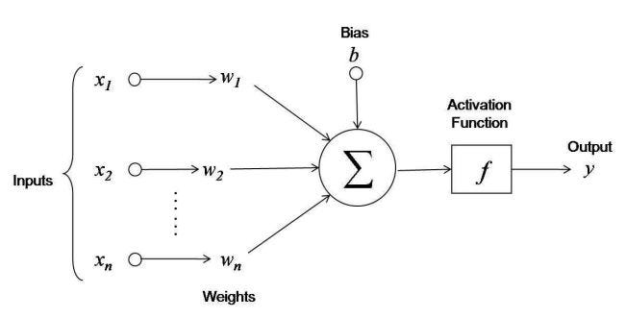
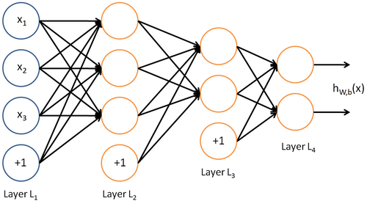
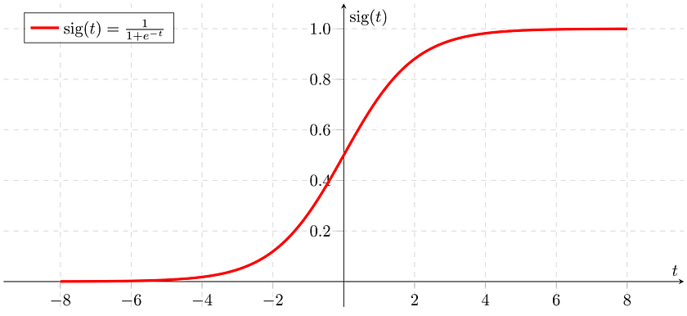

Neural Network
....the term “deep learning” comes from neural networks that contains several hidden layers, also called “deep neural networks”
3Blue1Brown; https://www.youtube.com/watch?v=aircAruvnKk

Slide 16
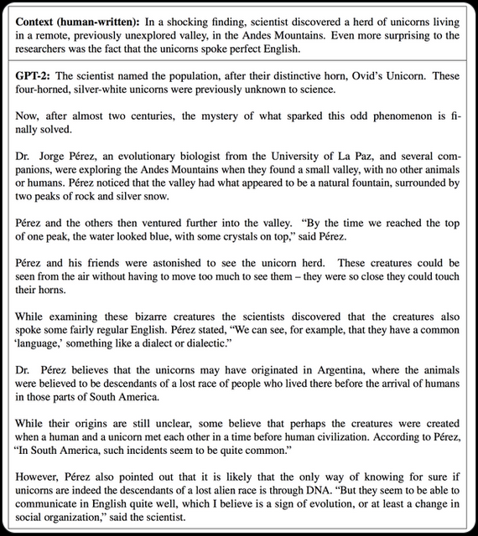


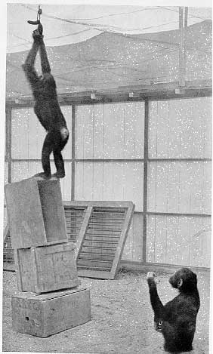

Type of learning/task
Generative AI
Supervised active learning
Pattern recognition /
Classification / Correlation
Problem solving / Transfer learning
Reinforcement learning
Notes:
While Wolfgang Kohler was interned at Tenerife, he devoted his energy to the study of Chimpanzees and their cognitive abilities. This picture is taken during one of the classical experiments where Kohler studied problem solving capacities. We see on the picture Grande’s attempts to reach to the treat hanging from the ceiling.

Slide 17
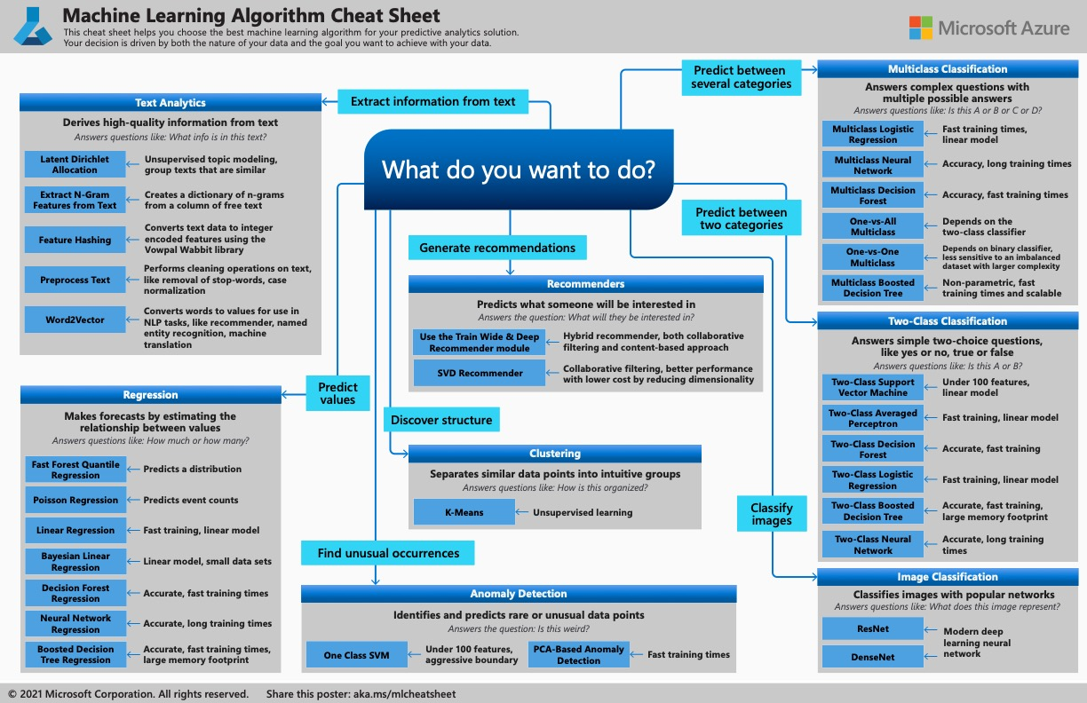

Slide 18
How do we build a deep learning model?

Slide 19

A minimal deep learning network (Perceptron)
Learning efficiency / loss function (loss = ”binary_crossentropy”, optimizer = "rmsprop")
Train data
activation = “relu”, units = 256
activation = “softmax”, units = 3
label
class
sample
A
A
category
Test data
B
A
B
Input
output
B
In machine learning,
a category in a classification problem is called a class.
Data points are called samples.
The class associated with a specific sample is called a label.
Model validation (metrics = “accuracy”)
Adapted from Deep Learning with R, Cholet & Allaire, 2019

Slide 20
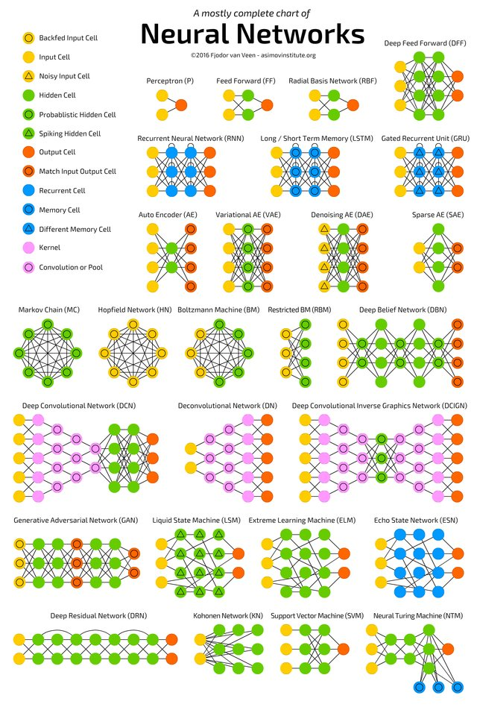
Choosing an architecture
Select model for the task
Start simple
Experiment with the topology or model flavor
Use data partitioning or K-fold cross validation
Run with simulations of the data
Compare methods/models to compare performance
Tune hyperparameters

Slide 21
Input data for Deep Learning models - Tensors -

Slide 22

Tensors as input for neural networks
Tensors are generalizations of vectors, that function as input for ML algorithms.
Let’s look at some examples

Slide 23
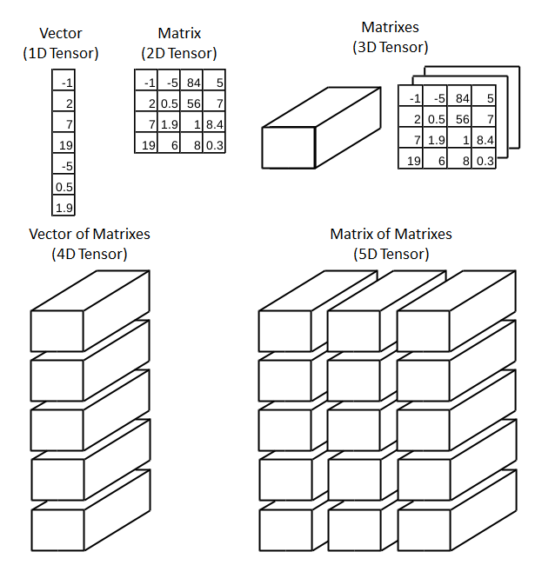
Tensors
1D Tensor: No real-world data
2D Tensor: Vector data
(samples, features)
3D Tensor: Time series or sequence
(samples, timesteps, features)
4D Tensor: Images (samples, height, width, channels) or (samples, channels, height, width)
5D Tensor: Video (samples, frames, height, width, channels)
https://towardsdatascience.com/deep-learning-introduction-to-tensors-tensorflow-36ce3663528f

Slide 24
Where to start?

Slide 25








Open Source Programming languages / frameworks
Statistics
Machine Learning
Deep Learning
Visualization
Bioinformatics
Statistics
Machine Learning
Deep Learning
Visualization
Bioinformatics
Natural Language Processing
Chem-informatics (RDKit)
Graph Database
Graph Visualization
Graph Algorithms
https://rviews.rstudio.com/2020/07/20/shallow-neural-net-from-scratch-using-r-part-1/
https://rviews.rstudio.com/2020/07/24/building-a-neural-net-from-scratch-using-r-part-2/

Slide 26
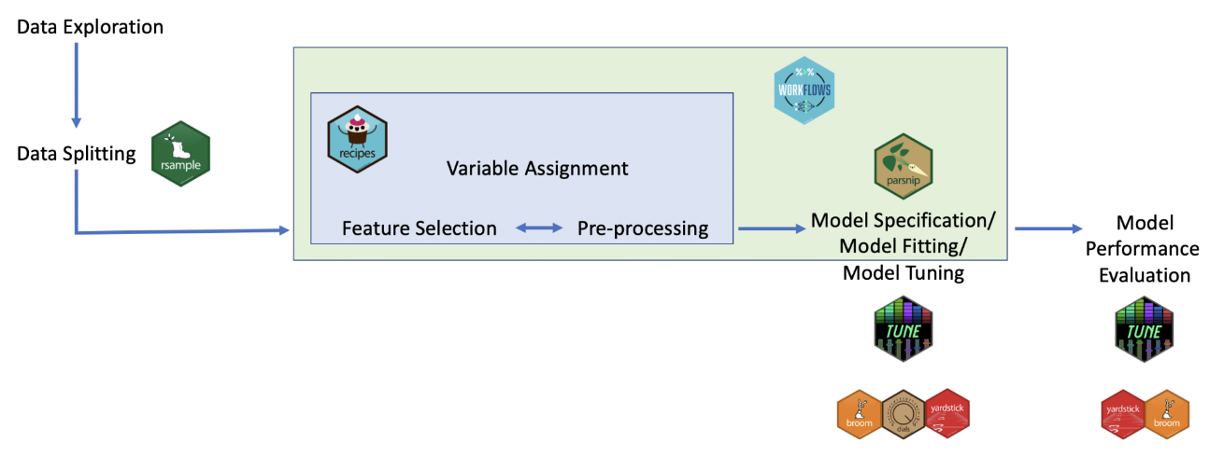
Tidymodels (hands on example)
Split data
Model specification
Recipe (algorithm, engine, task, data, predictors)
Workflow (model specs + recipe)
Tune
Fit
Test
Evaluate

Slide 27
Hands-on AI examples in Toxicology (in R)

Slide 28
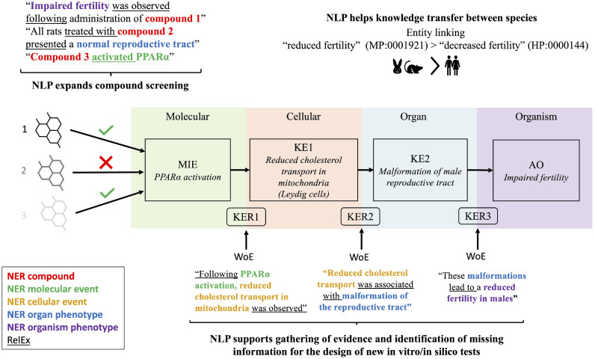
AI for information extraction; solving FAIR in Tox?
https://doi.org/10.1016/j.bbiosy.2022.100061

Slide 29

Posit cloud: https://tinyurl.com/4xwp25zz
Posit Cloud intro -> https://www.youtube.com/watch?v=-fzwm4ZhVQQ
Materials -> https://github.com/VHP4Safety/pet-nams-ml
Reader -> https://rstudio-connect.hu.nl/mltox/

